Slide 1
Environmental Pollution

Slide 2
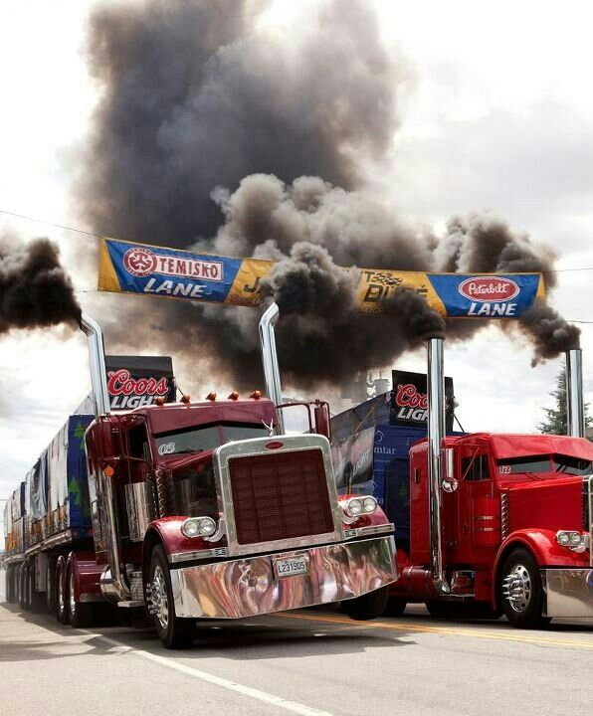
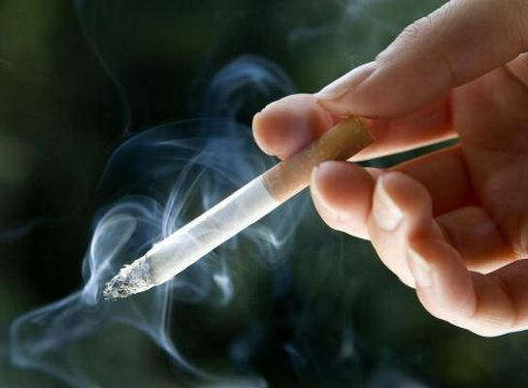
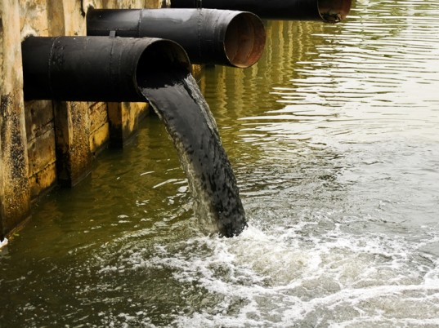
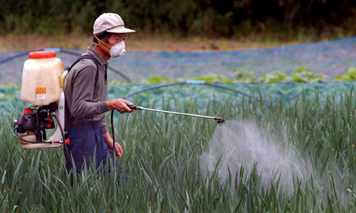
What is Environmental Pollution?
When pollutants are introduced into the environment and negatively change its natural state.
Example of pollutants:

Slide 3
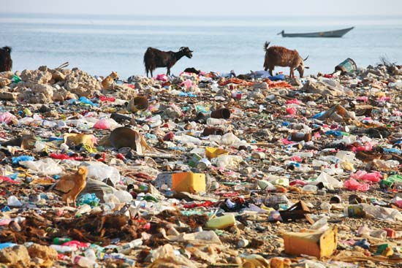
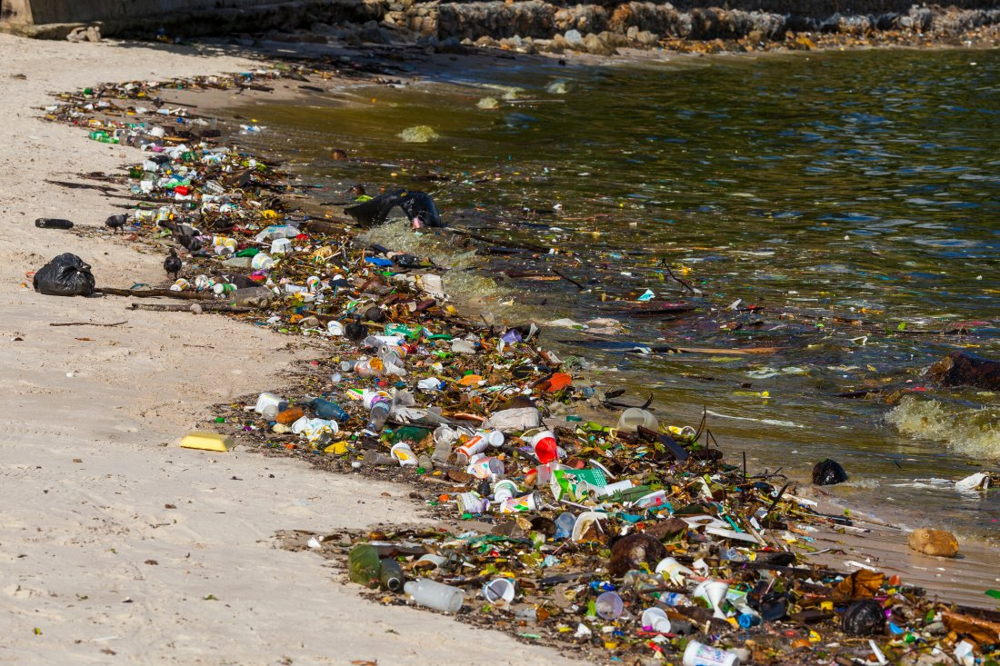
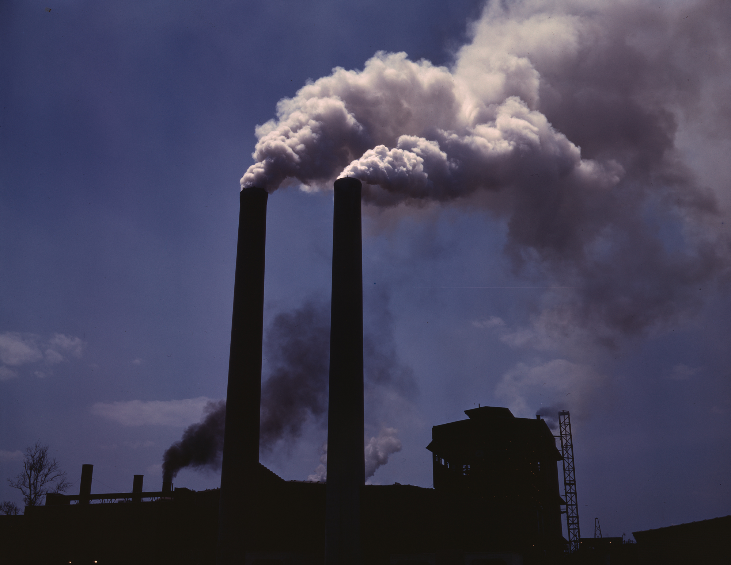
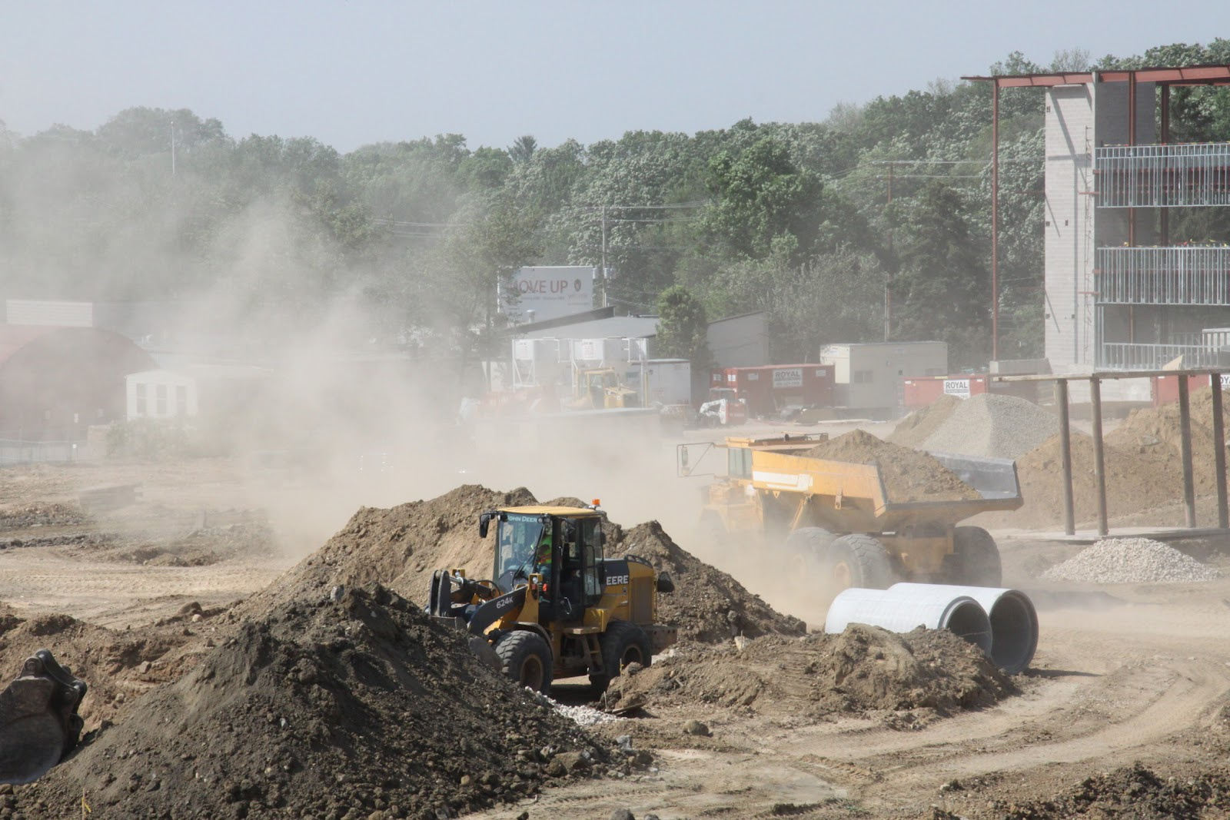
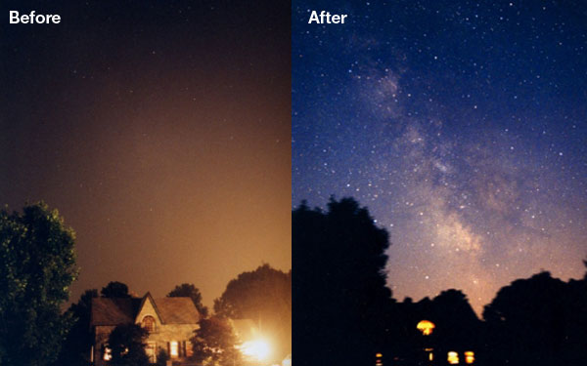
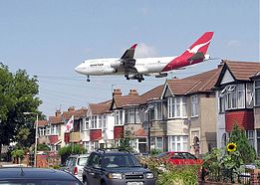
Types of Pollution
land
water
smoke/gas
construction/manufacturing
light
noise

Slide 4
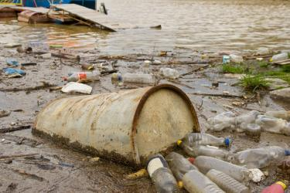
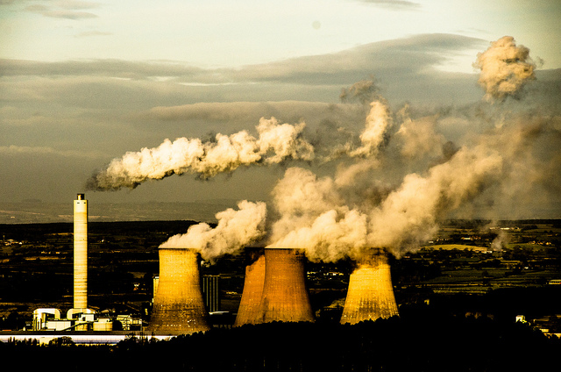
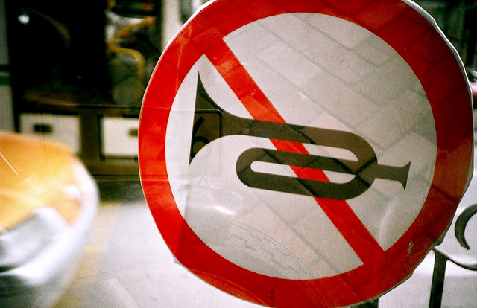
Choose One Type of Pollution
Research
Write in your own words how it affects the environment, why it is a problem, and offer one solution to solve the issue.
Example:
Water pollution affects the environment by contaminating the water. This is a problem because it causes harm to the animals that need the water to survive. One solution would be to remove the trash from the water.

Slide 5
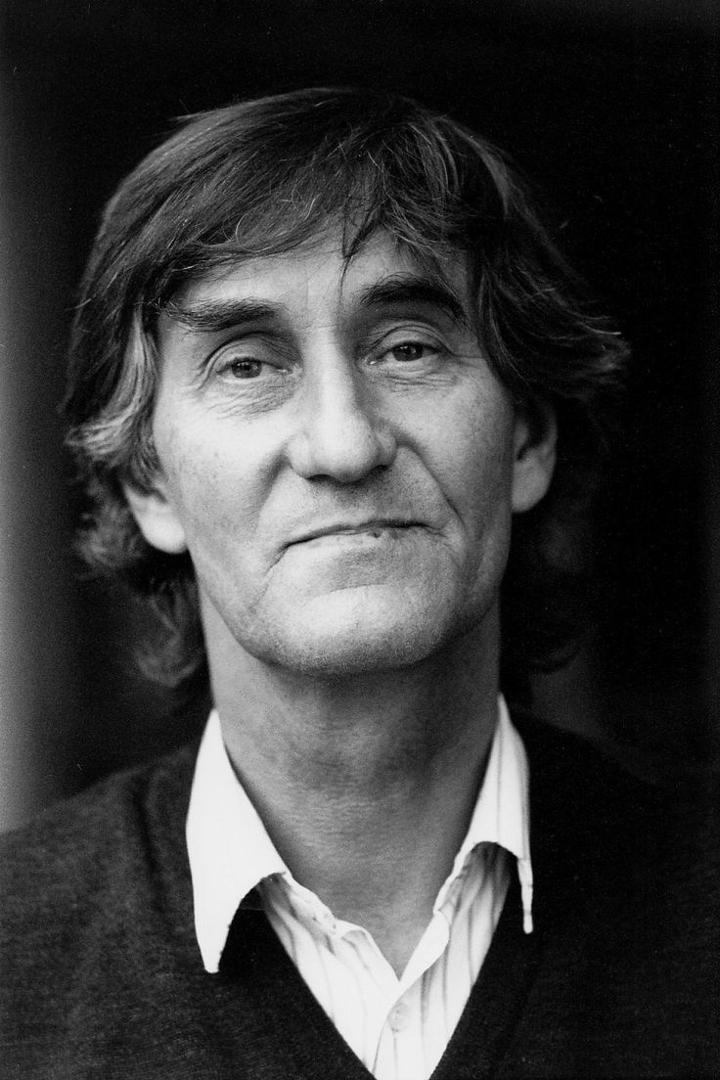
Nils Udo
Bavarian environmental artist
working directly with nature since 1972
works on site using found berries, leaves, sticks, the movement of water, the growth of plants
Each piece is in response to the landscape and materials he finds around him

Slide 6
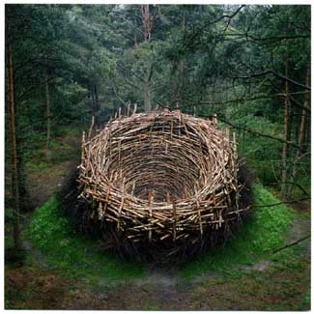
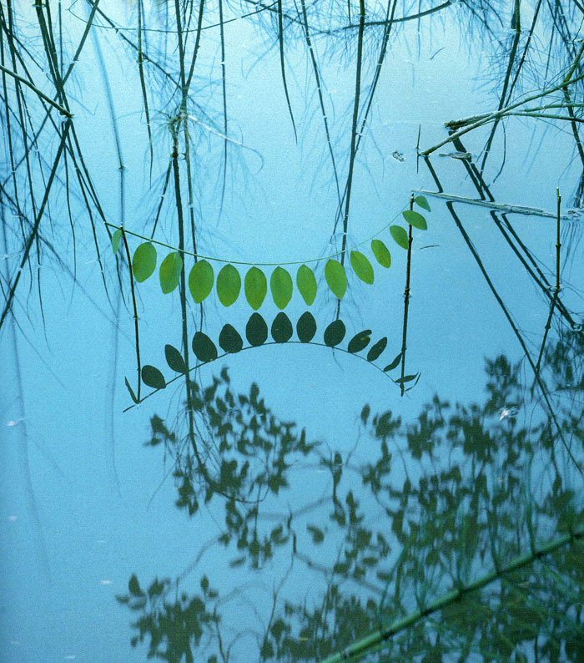
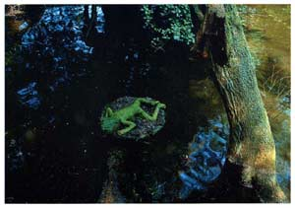
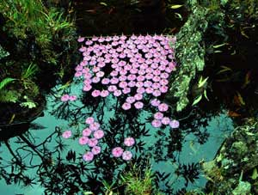
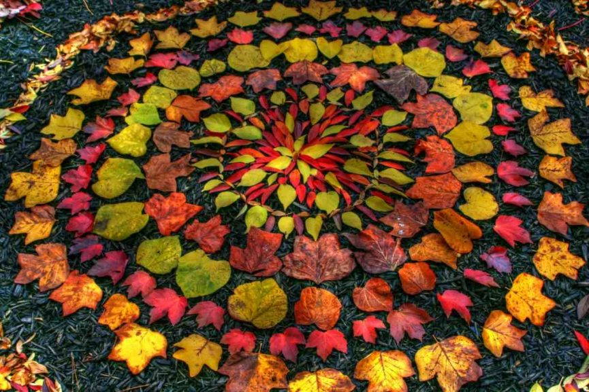
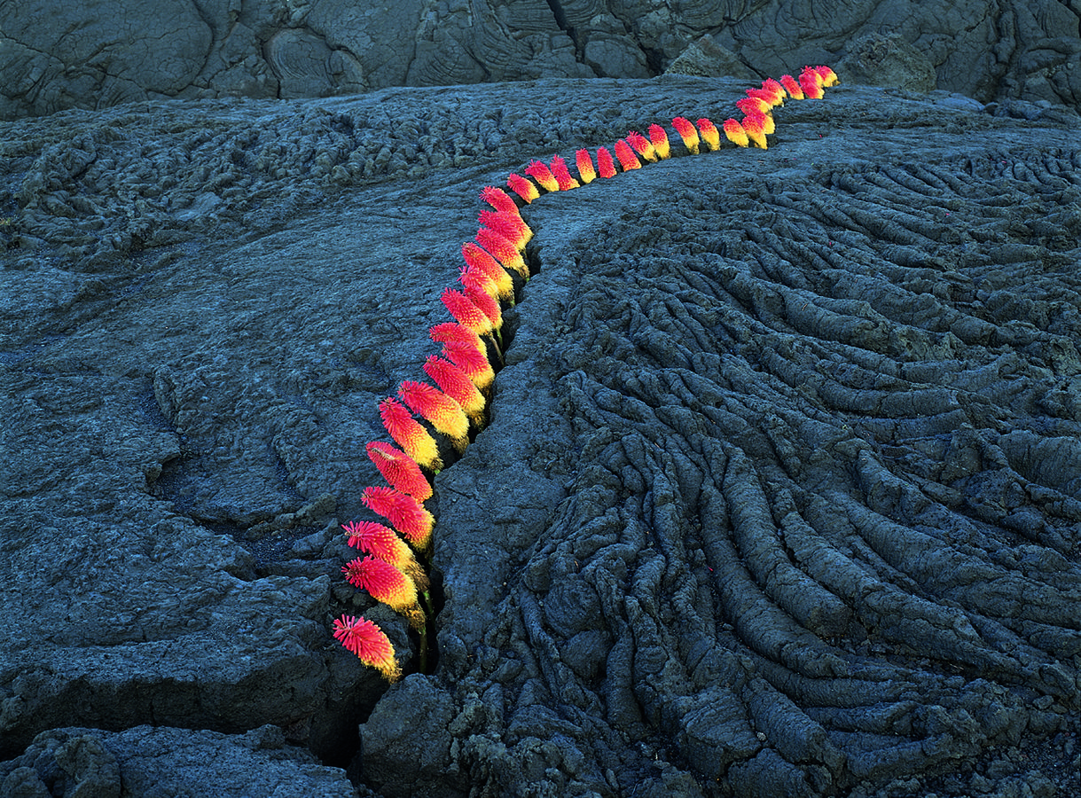

Slide 8
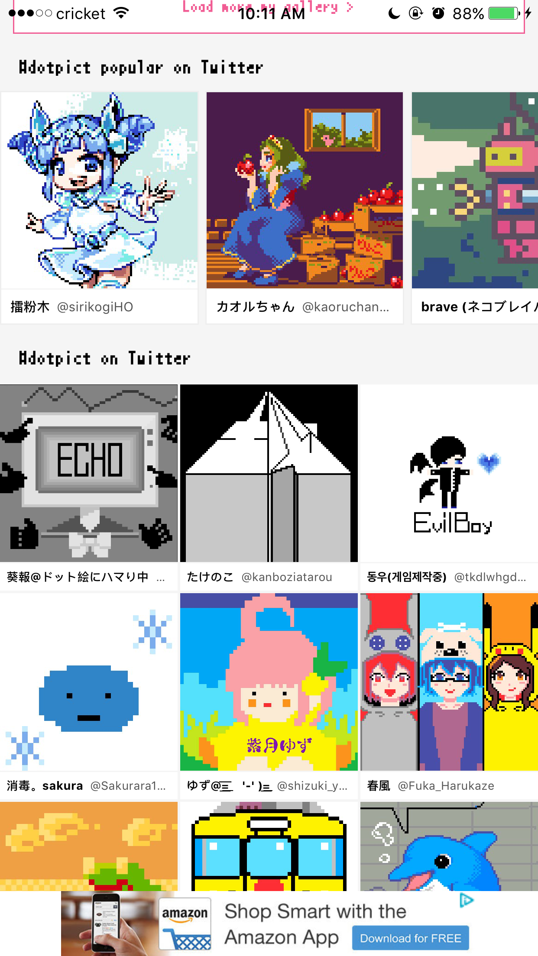

Slide 9
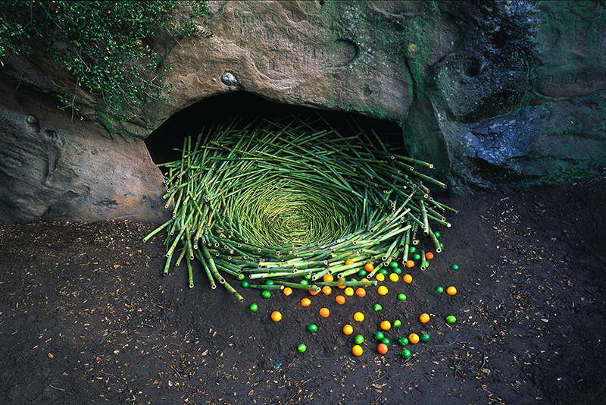
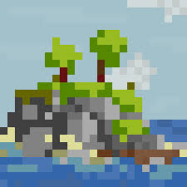
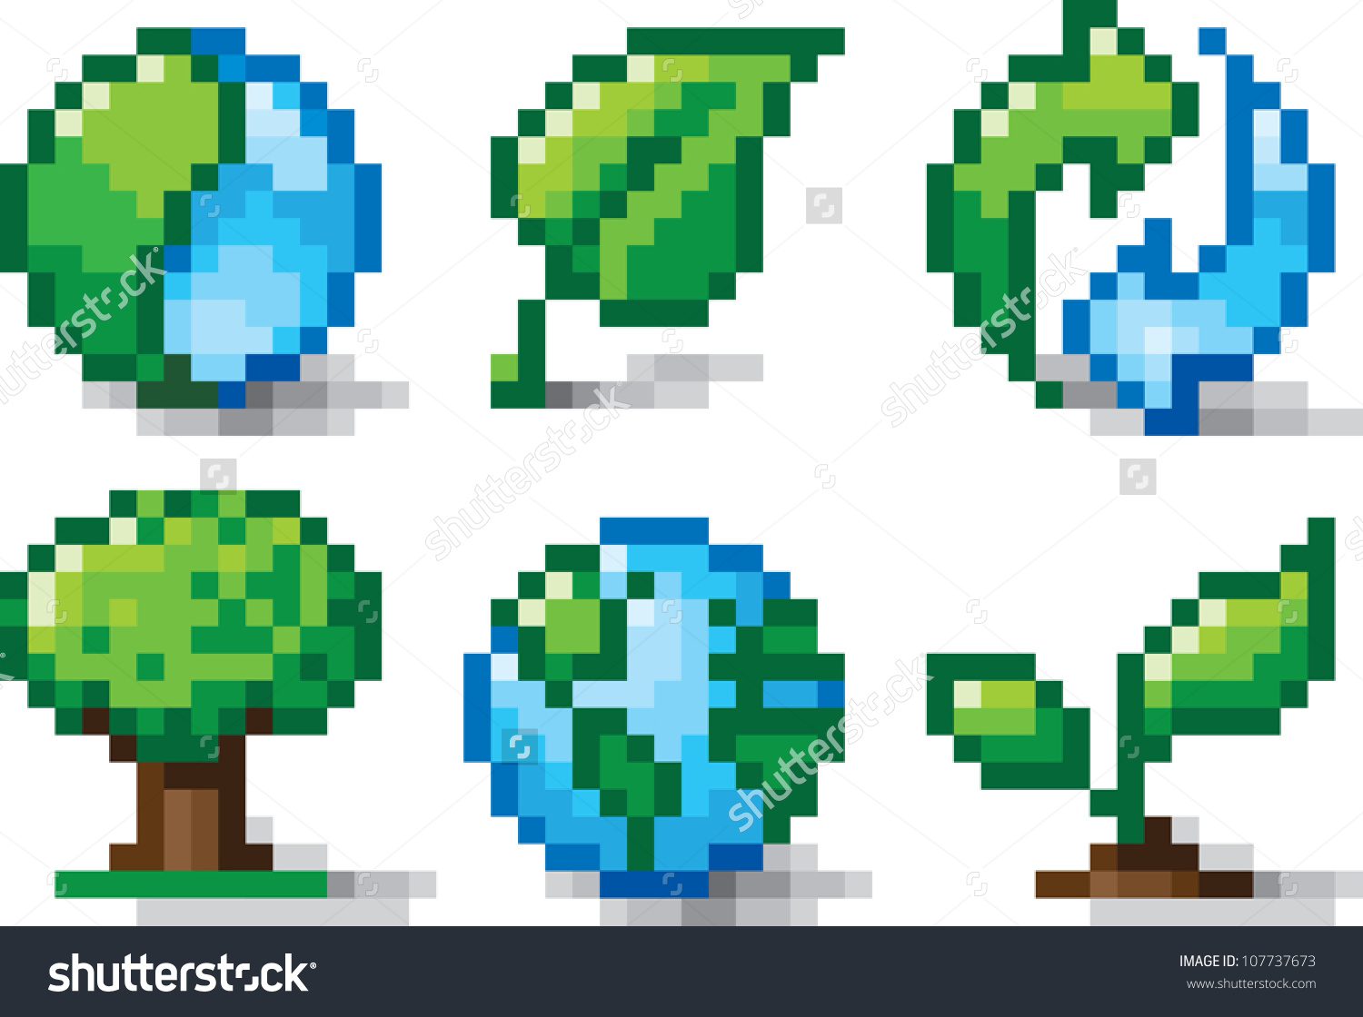
Why pixel art?
Similarities between environmental art (Nils Udo) and pixel art
Both have their limitations and challenges
Environmental art like Udo’s work limits him to only using the surrounding environment to work with
Pixel art, or in this case dotpict pixel art, also has its limitations (limited palette, limited canvas space, no layers, no line/shape tools)
Challenge/critical thinking
How to create or recreate an image that will be read how you intended it to be (will your pixelated object look like what its supposed to be to someone else?)

Slide 10
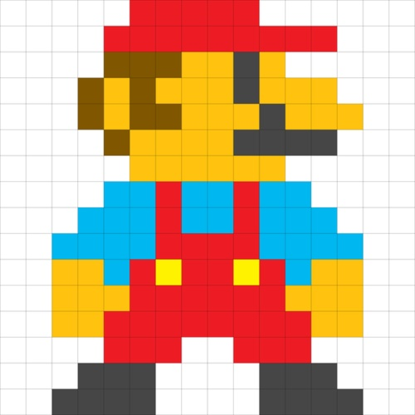
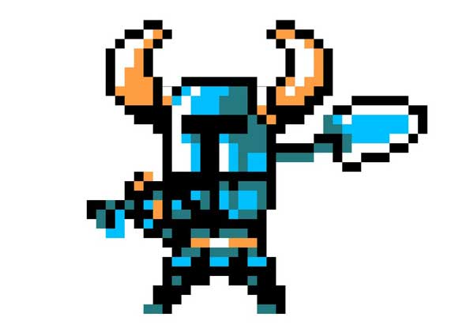
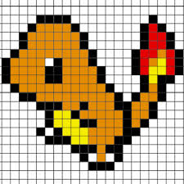
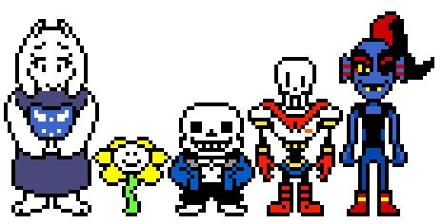
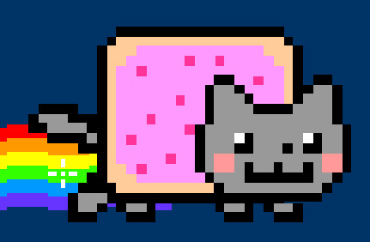

Slide 11
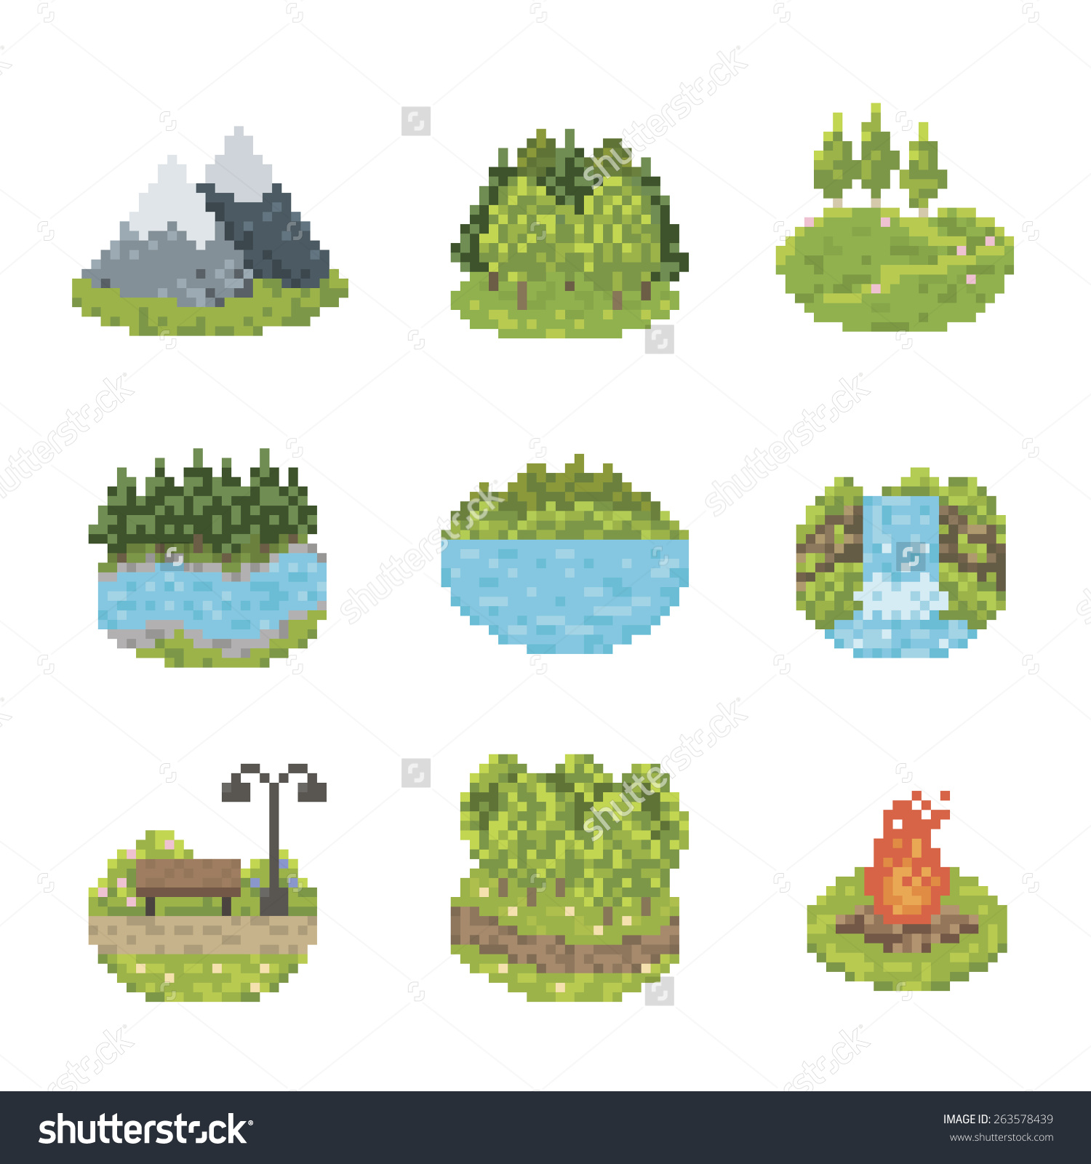
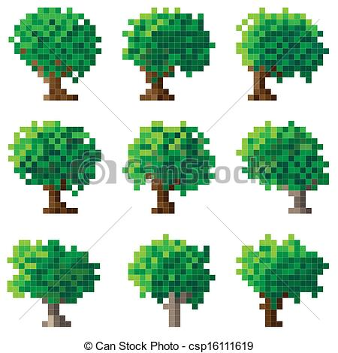
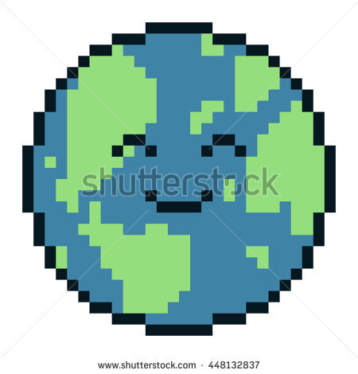
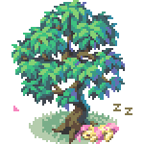

Slide 12
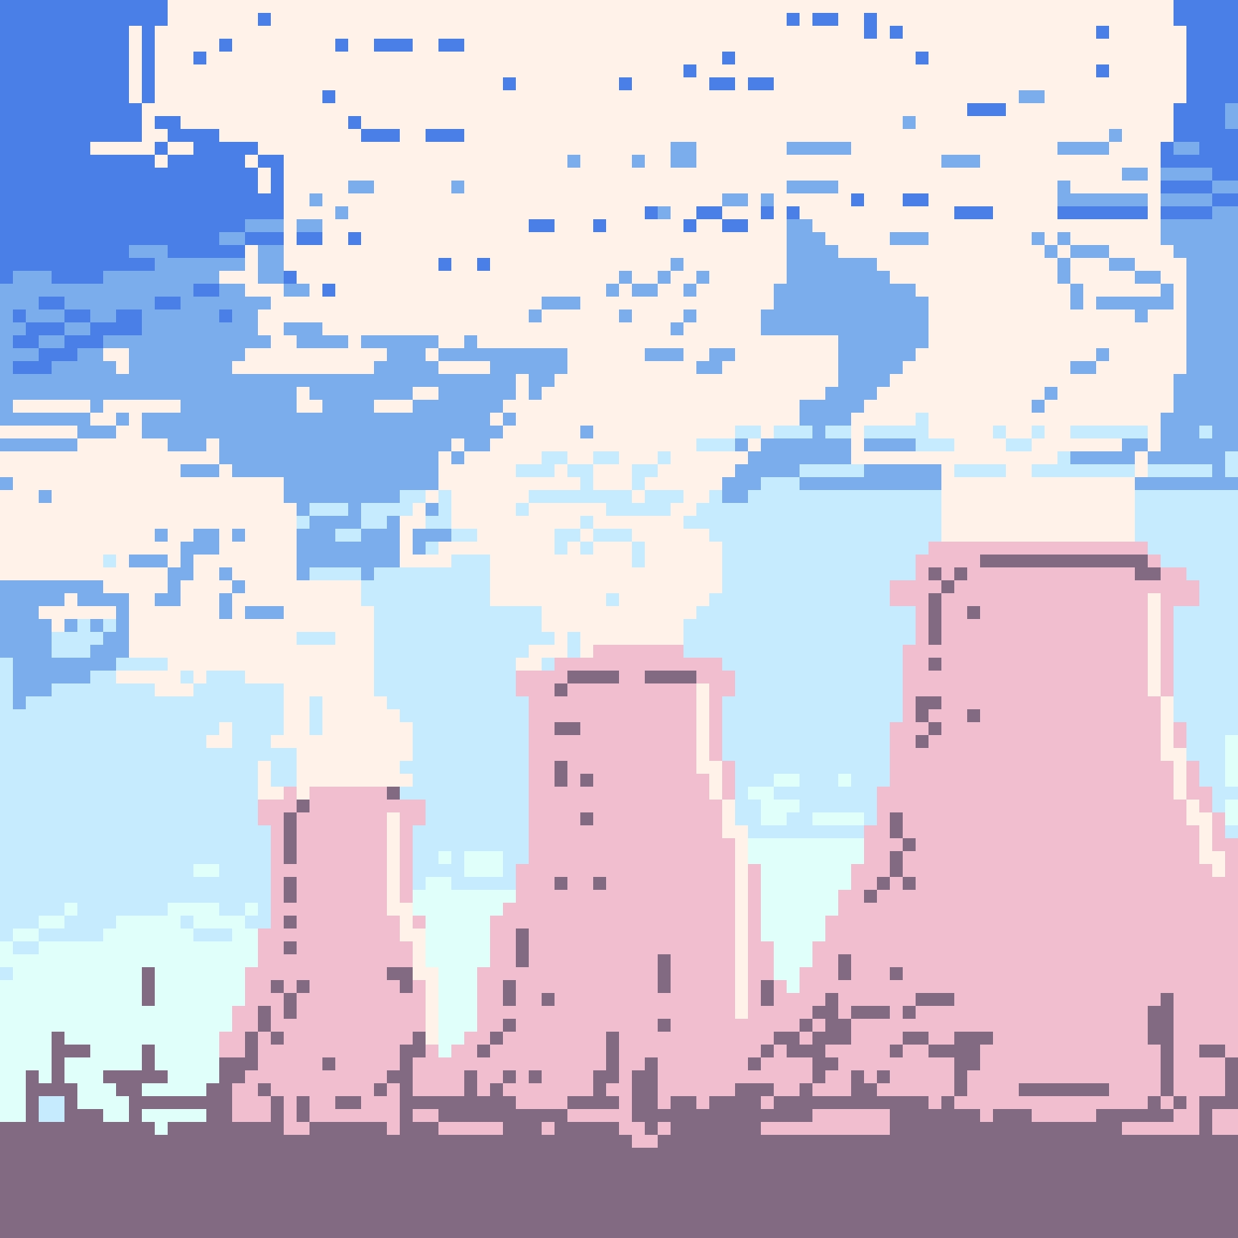
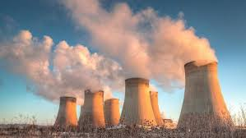
Recreate
Create a pixel art piece related to the environment
You can recreate an already-existing photo or image into pixel form
Example I made (right):

Slide 13
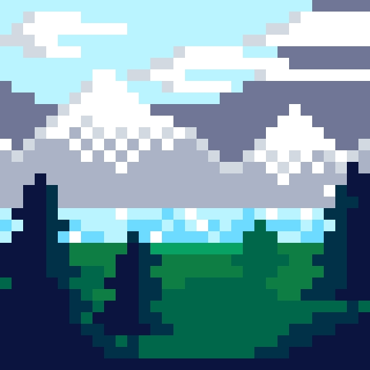
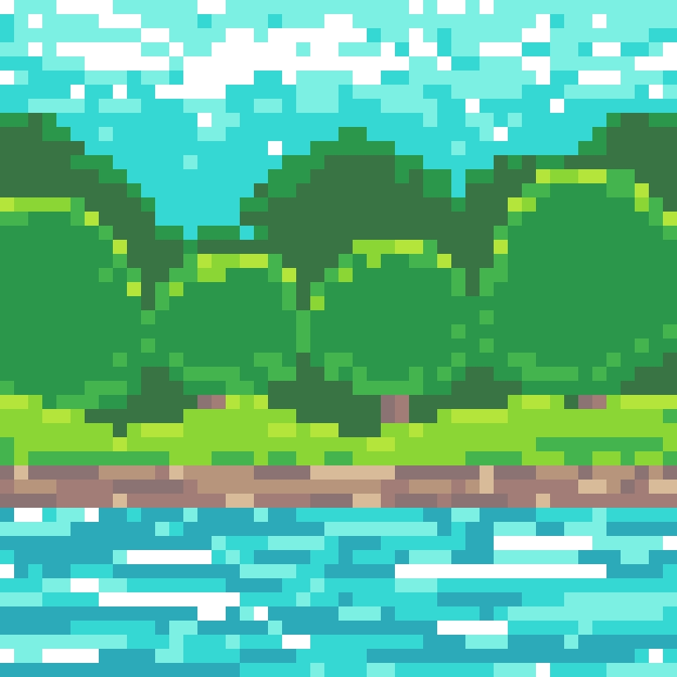
Make Your Own
Or you can come up with your own idea
Examples I made:

