Slide 1
The color wheel

Slide 2
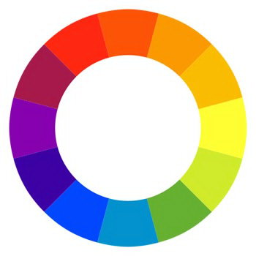
Red
Red-violet
Red-orange
Violet
Orange
Blue-violet
Yellow-orange
Blue
Yellow
Blue-green
Yellow-green
Green

Slide 3
Primary Colors
Tertiary Colors
Secondary Colors

Slide 4
Primary
Primary
Secondary
+
=
+
=
Tertiary
Primary
Secondary
+
=
+
=

Slide 5
Cool Colors
Warm Colors

Slide 6
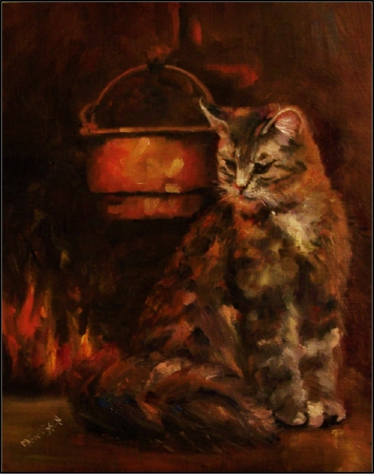
Warm or Cool?
Warm
Cool

Slide 7
Color Combinations
Monochromatic
Complementary
Analogous
Triad
Three hues equally positioned on a color wheel.
Colors located adjacent to each other on a color wheel.
Colors across from each other on a color wheel.
Colors that are shade or tint variations of the same hue.

Slide 8
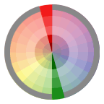
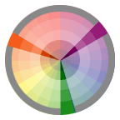
Complementary
Triad
Monochromatic
Analogous

Slide 9
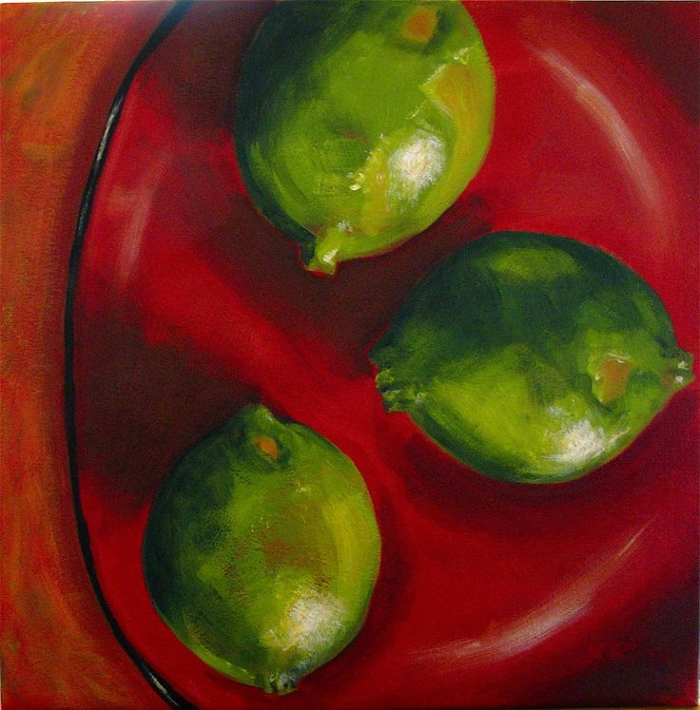
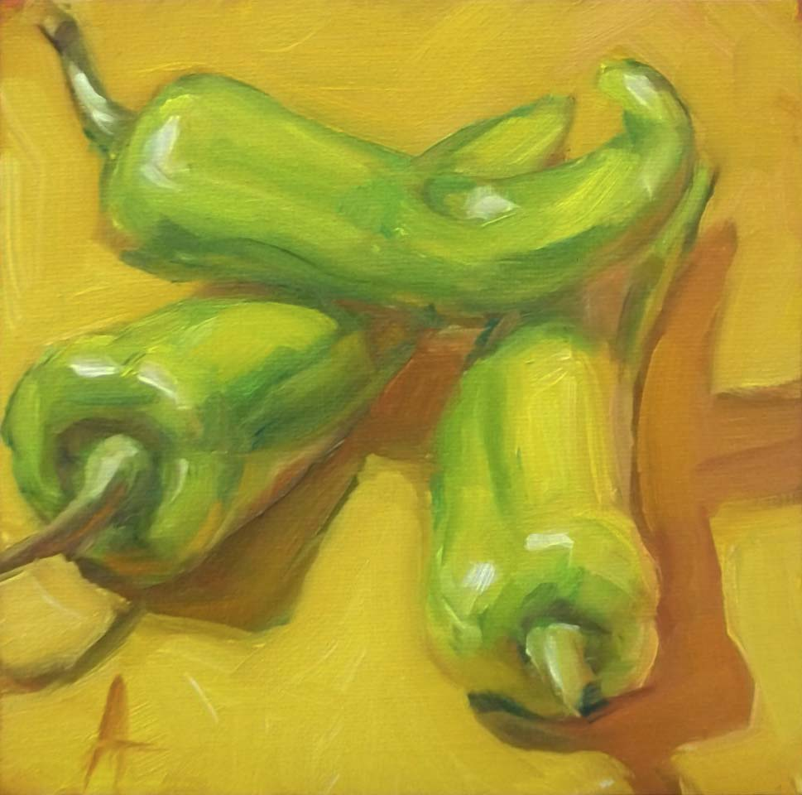
Which Color Combo?
Monochromatic
Complementary
Analogous
Triad

